Slide 1
Introduction to SQL
Lecture 3

Slide 2
SQL - Advantages
Stands for Structured Query Language
Low training cost – simple language
Fixed rigid simple syntax
Independent of Operating system
Independent of Data Base
Provides interconnection between forms, reports and all applications with the DB

Slide 3
SQL Categories
DDL
Data Definition Language
Used to create database elements such as tables, views
DML
Data Manipulation Language
Used to process data such as selecting, Inserting, deleting data
DCL
Data Control Language
Used by database administrator to give privileges to users, back up, tuning performance,

Slide 4
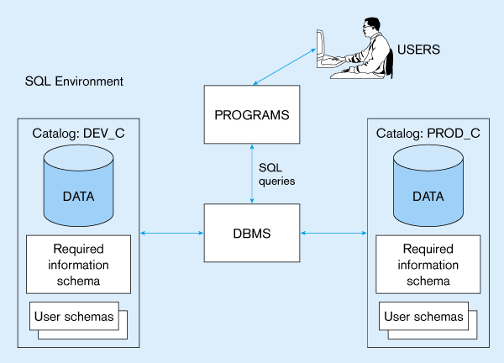
A simplified schematic of a typical SQL environment, as described by the SQL-92 standard

Slide 5
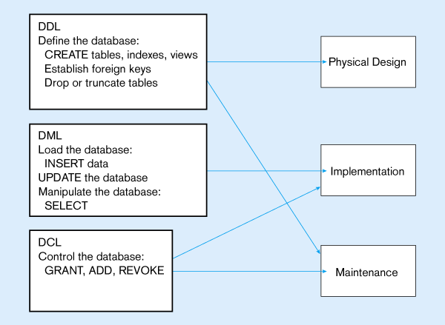
DDL, DML, DCL, and the database development process

Slide 6
Relational Tables
Table Name
COURSE
Field Names
CRS : Code for the course
CTITLE Course Title
CHRS Course Hours
CHRSW Course Hours per week

Slide 7
Relational Tables

Slide 8
Relational Tables
Note the following
The intersection between each column and row has only one value
No two rows has identical values
No order is assumed.
When inserting new row, its location is not known
The table can be represented as
COURSE (CRS, CTITLE, CHRS, CHRSW)

Slide 9
ORACLE Basic data types
String types
CHAR(n)
fixed-length character data
n characters long
VARCHAR2(n)
variable length character data
maximum 4000 bytes in oracle 9 I
LONG
variable-length character data
up to 4GB
Maximum 1 per table

Slide 10
ORACLE Basic data types
Numeric types
NUMBER(p,q)
General purpose numeric data type
Total width = p, out of which q decimal numbers
INTEGER(p)
Signed integer, p digits wide
FLOAT(p)
Floating point in scientific notation with p binary digits precision
Date/time type
DATE
Length date/time in dd-mm-yyyy/hh:mm:ss form

Slide 11
Table Keys
Primary Keys
Uniqueness
NOT NULL
Minimum Number of columns
Foreign Keys
Used to relate rows of two or more tables
Foreign key at the child table should be of the same type (and values) of the primary key at the parent table

Slide 12
Example of relationships
OFF LOC
01 RIYAD
02 JEDDAH
Table LOCATION
Parent
Primary Key
CRS OFF ODATE
701 01 21-SEP-91
701 02 16-NOV-91
702 01 26-NOV-91
702 02 01-FEB-92
Table Offer
Child
Foreign Key
Comes from LOCATION.OFF

Slide 13
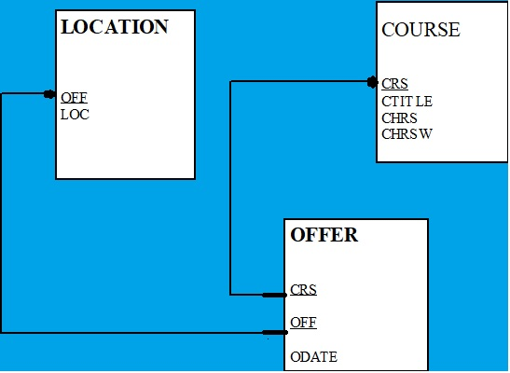
Example of Database Tables
COURSE (CRS, CTITLE, CHRS, CHRSW)
OFFER (CRS, OFF, ODATE)
LOCATION (OFF, LOC)

Slide 14
Questions
Determine suitable data types and lengths for fields in previous tables
If we want to add data for PERSONS who ATTEND offer of courses. How many tables should be added? What relations are required?
Note data of persons are ID, Name, and address.
Determine also primary and foreign key for new tables and suitable field types and widths.

Slide 15
Database Operations

Slide 16
Creating tables
CREATE TABLE TableName
(Column-definition [,Column-definition] ) ;
Column-definition is
ColumnName data-type [Constraint]

Slide 17
Naming tables
Start with Alphabetical
Special characters as ( _, #, ) and numbers are allowed
Not case sensitive (emp, Emp, EMP)
Unique name within account
Not an sql reserved word as Select, Update, ….
Not more that 30 characters

Slide 18
Example
Example for creating table PERSONS
CREATE TABLE PERSONS
( CODE NUMBER(3,0) NOT NULL,
NAME VARCHAR2(50) NOT NULL,
ADDRESS VARCHAR2(50)
);
Constraints Example
NOT NULL
PRIMAEY KEY

Slide 19
Default values
CREATE TABLE INVOICE
( INV_NUM NUMBER(4,0) NOT NULL,
INV_TOTAL NUMBER(10,3) DEFAULT 0,
INV_DATE DATE DEFAULT SYSDATE
);

Slide 20
Removing table
Syntax
DROP TABLE TableName ;
Example
DROP TABLE PERSONS;
Note:
The difference between Drop and DELETE keywords

Slide 21
Changing table design ALTER TABLE
Adding new fields
ALTER TABLE PERSONS
ADD (IDNUMBER VARCHAR2(10) );
Modifying Field definition
ALTER TABLE PERSONS
MODIFY (IDNUMBER VARCHAR2(20));

Slide 22
Operations on Relations

Slide 23
Operations on relations
In a relational database, we can define several operations to create new relations out of the existing ones.
Basic operations:
Insert
Delete
Update
Select
Project
Join
Union
Intersection
Difference

Slide 24
Insert operation
An unary operation.
Insert a new tuple into the relation.

Slide 25
Insert
insert into RELATION-NAME values ( … , … , … )
insert into COURSES values ( “CIS52”,”TCP/IP”, 6 )

Slide 26
Delete operation
An unary operation.
Delete a tuple defined by a criterion from the relation.

Slide 27
Delete
delete from RELATION-NAME where criteria
delete from COURSES where No=“CIS19”

Slide 28
Update operation
An unary operation.
Changes the value of some attributes of a tuple.

Slide 29
Update
update RELATION-NAME set attribute1=value1, attribute2=value2, … where criteria
update COURSES set Unit=6 where No=“CIS51”

Slide 30
Select operation
An unary operation.
It is applied to one single relation and creates another relation.
The tuples in the resulting relation are a subset of the tuples in the original relation.
Use some criteria to select

Slide 31
Select
select * from RELATION-NAME where criteria
select * from COURSES where Unit=5

Slide 32
Project operation
An unary operation.
It is applied to one single relation and creates another relation.
The attributes in the resulting relation are a subset of the attributes in the original relation.

Slide 33
Project
select attribute-list from RELATION-NAME
select No, Unit from COURSES

Slide 34
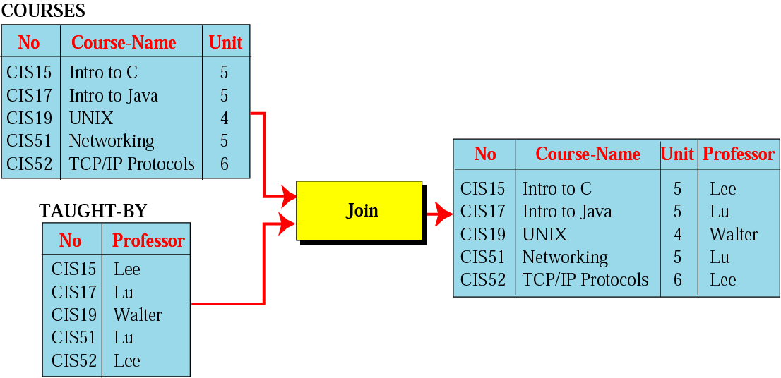
Join operation
A binary operation.
Combines two relations based on common attributes.

Slide 35
Join
select attribute-list from RELATION1,RELATION2 where criteria
select No,Course-Name,Unit,Professor from COURSES,TAUGHT-BY where COURSES.No=TAUGHT-BY.No

Slide 36
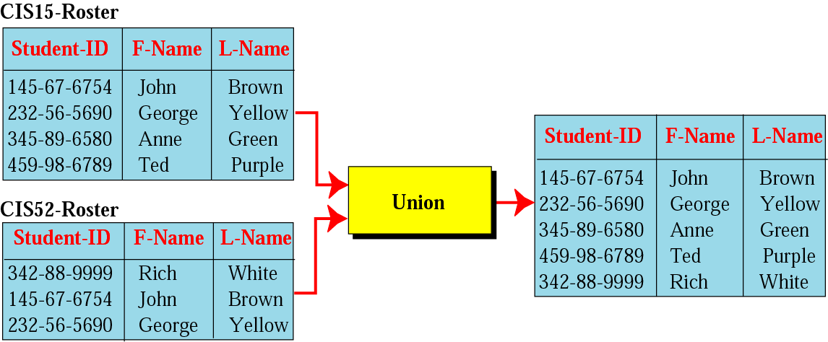
Union operation
A binary operation.
Creates a new relation in which each tuple is either in the first relation, in the second, or in both.
The two relations must have the same attributes.

Slide 37
Union
select * from RELATION1 union select * from RELATION2
select * from CIS15-Roster union select * from CIS52-Roster

Slide 38
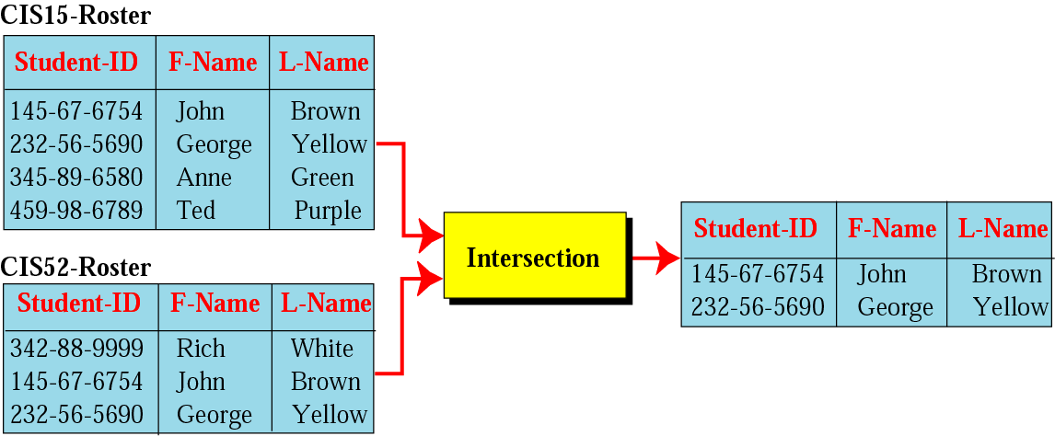
Intersection operation
A binary operation.
Creates a new relation in which each tuple is a member in both relations.
The two relations must have the same attributes.

Slide 39
Intersection
select * from RELATION1 intersection select * from RELATION2
select * from CIS15-Roster intersection select * from CIS52-Roster

Slide 40
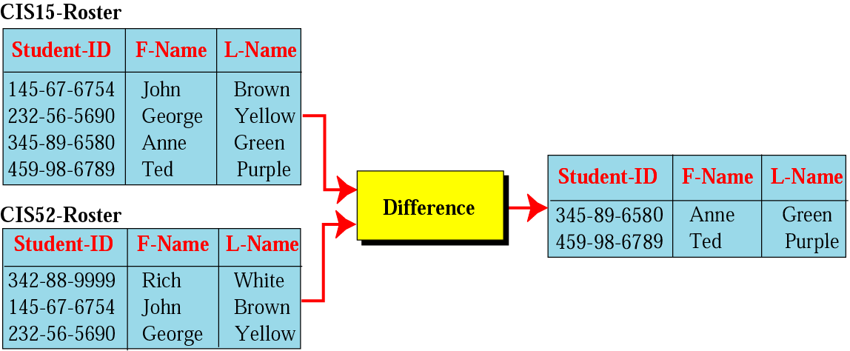
Difference operation
A binary operation.
Creates a new relation in which each tuple is in the first relation but not the second.
The two relations must have the same attributes.

Slide 41
Difference
select * from RELATION1 minus select * from RELATION2
select * from CIS15-Roster minus select * from CIS52-Roster

